Slide 1


COMPUTER NETWORKS 18CSC302J
MINI PROJECT FOR SEMESTER 5
NETWORK DESIGN PROPOSAL FOR SMALL BUSINESS ORGANIZATION

Slide 2

TEAM MEMBERS: -
1. PRATUL SINGH (RA2011003010193)
SWAPNIL ROOP RAI (RA2011003010155)
VAIBHAV MAHAJAN (RA2011003010161)
ROHAN JOHN SANTOSH (RA2011003010158)
CSE C1 SECTION

Slide 3
ABSTRACT: -
This project aims to design a suitable network system for colleges/campuses in developing countries and to design a network with high security and low cost. This project will help to enhance the education of developing countries.
The advantages of networking can be seen clearly in terms of efficiency, security, manageability, and cost as it allows collaboration between users in a wide area. To improve college campus network design, the technology used was creating LAN and WLAN and using a cheap device to reduce the cost of the network.
But the network can also become better by using routing protocols and other protocols. So, we are going to use such protocols using a smaller number of devices and will also maintain the low cost of the network.
The network was constructed and implemented on the college campus. Students can successfully connect and utilize the internet, provided they enter the correct admin details. Teachers can also connect to the network that has been set up.

Slide 4
INTRODUCTION: -
The network is referred to as connecting computers electronically to share information. Resources such as a file, applications, printers & software are some common information shared in the networking. The advantage of networking can be seen clearly in terms of security, efficiency, manageability & cost-effectiveness as it allows collaboration between the users in a wide range. The Switches and Routers play an important role in data transfer from one place to another.
We designed a computer network for a college/campus. There are 50 users in the college. 20 users in the main building, 20 users in the annex campus tech park building, and 10 users in the annex campus hospital block. Every building has a lobby which is 200 square feet of open space, where wireless access to the network is required. Only authorized personnel should have access to the wireless network.

Slide 5
INTRODUCTION(contd.): -
The distance between the annex campus hospital block and the main building is 300 meters. The distance between the annex campus tech park and the main building is 90 meters. The distance between the annex campus hospital block and tech park is 70 meters. A high-speed cable internet connection is available in the main building which is shared among the users.

Slide 6
IMPLEMENTATION: -
For Main Building: In the main building, there are 20 users which are provided with the high-speed internet wirelessly, and only authorized persons are given access to the network for this purpose we have used the WRT300N router which is a wireless router and is capable of providing highspeed internet to the users within its range. For providing the internet we are using DHCP protocol.
Dynamic Host Configuration Protocol (DHCP) is a client/server protocol that automatically provides an Internet Protocol (IP) host with its IP address and other related configuration information such as the subnet mask and default gateway. The Network address used here is 192.168.0.0. For protection purposes, this router is using WPA2-PSK authentication which has a PSK pass phase. This passkey will be provided only to the authorized personnel.

Slide 7
IMPLEMENTATION(contd.): -
For Tech Park Building and Hospital Block Building: In the tech park building, 20 users are all connected to the same network using switches. In the hospital block, 10 users are all connected to the same network using switches. We are using 2960-244TT switches to connect PCs in different rooms and to connect all of the switches we are using a 3560-24PS switch which is a Multi-layered switch. The network address we used in Tech Park is 193.161.155.0. The network address used in the hospital block is 193.161.158.0
It is necessary to protect these networks from unauthorized users and prevent them from hacking, so it is necessary to maintain security in these networks by using various security options. To implement this, we need the best devices that can support these protocols more efficiently. So, we decided to use multi-layered switches which work as a switch as well as a router and using this router it is possible to implement the EIGRP routing protocol.

Slide 8
IMPLEMENTATION(contd.): -
By using EIGRP it is possible for load balancing on parallel links between sites and also manages load balancing. Both the buildings are then connected to the main building’s router using a fast Ethernet connection so to provide the internet connection available in the main building to the tech park and the hospital block.
The topology we used here is BUS topology as we have to provide the internet
connection to all the users using the main building’s internet connection.

Slide 9
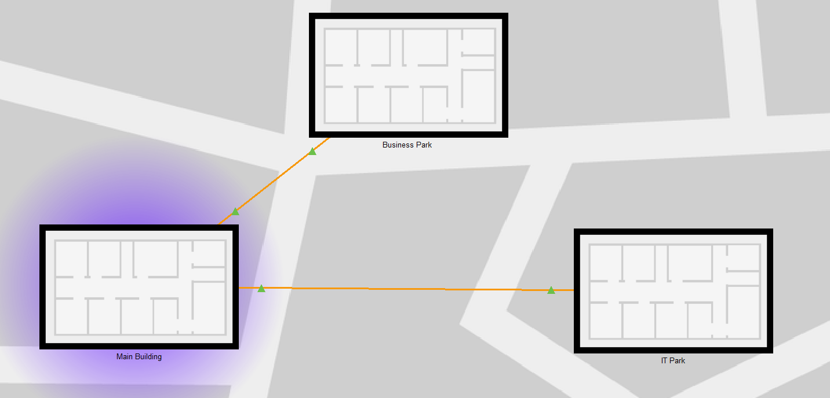
ARCHITECTURE AND DESIGN: -

Slide 10
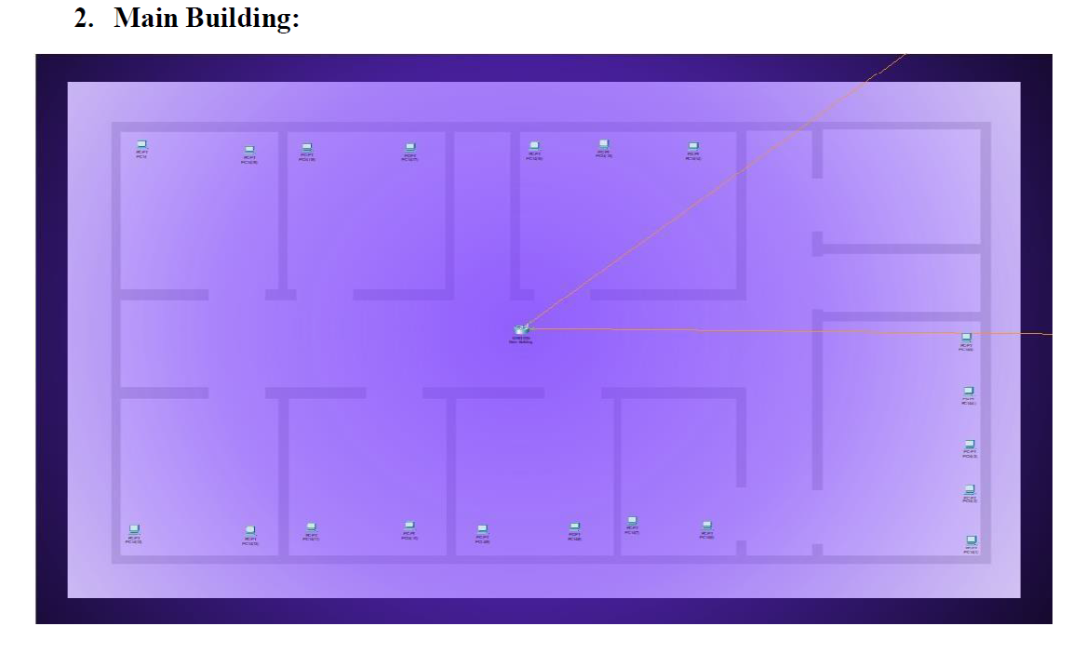

Slide 11
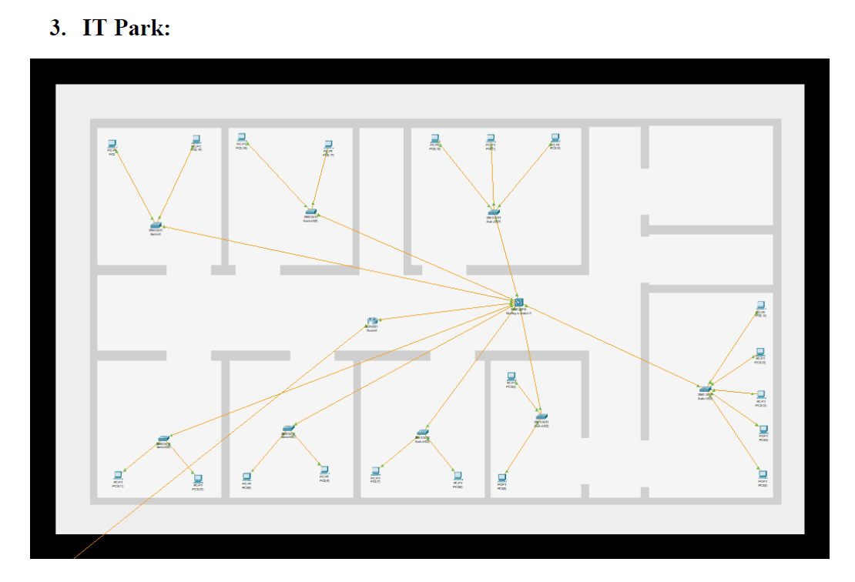

Slide 12
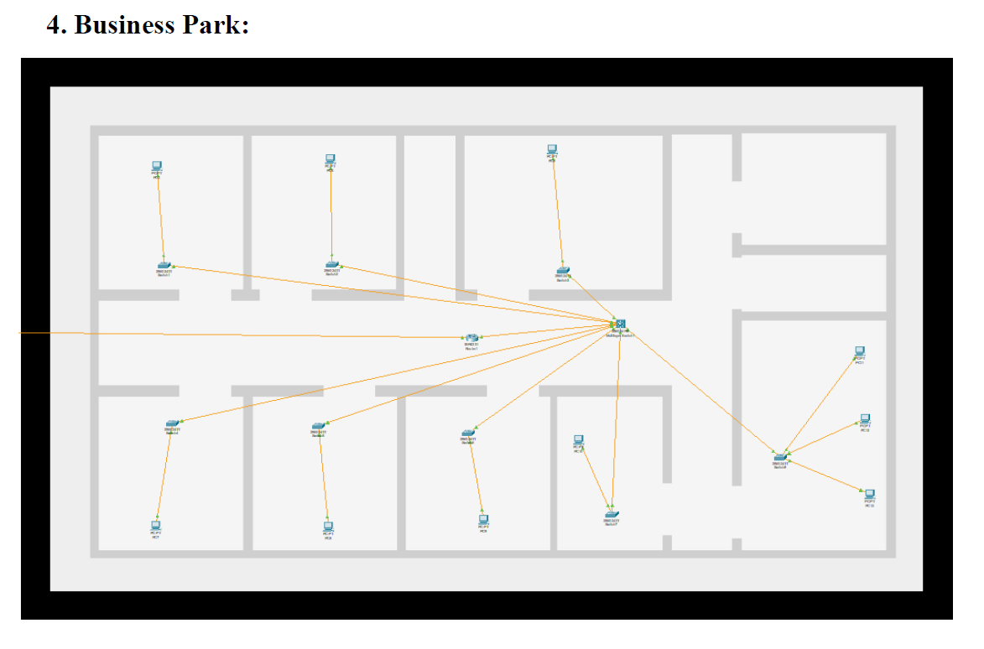

Slide 13

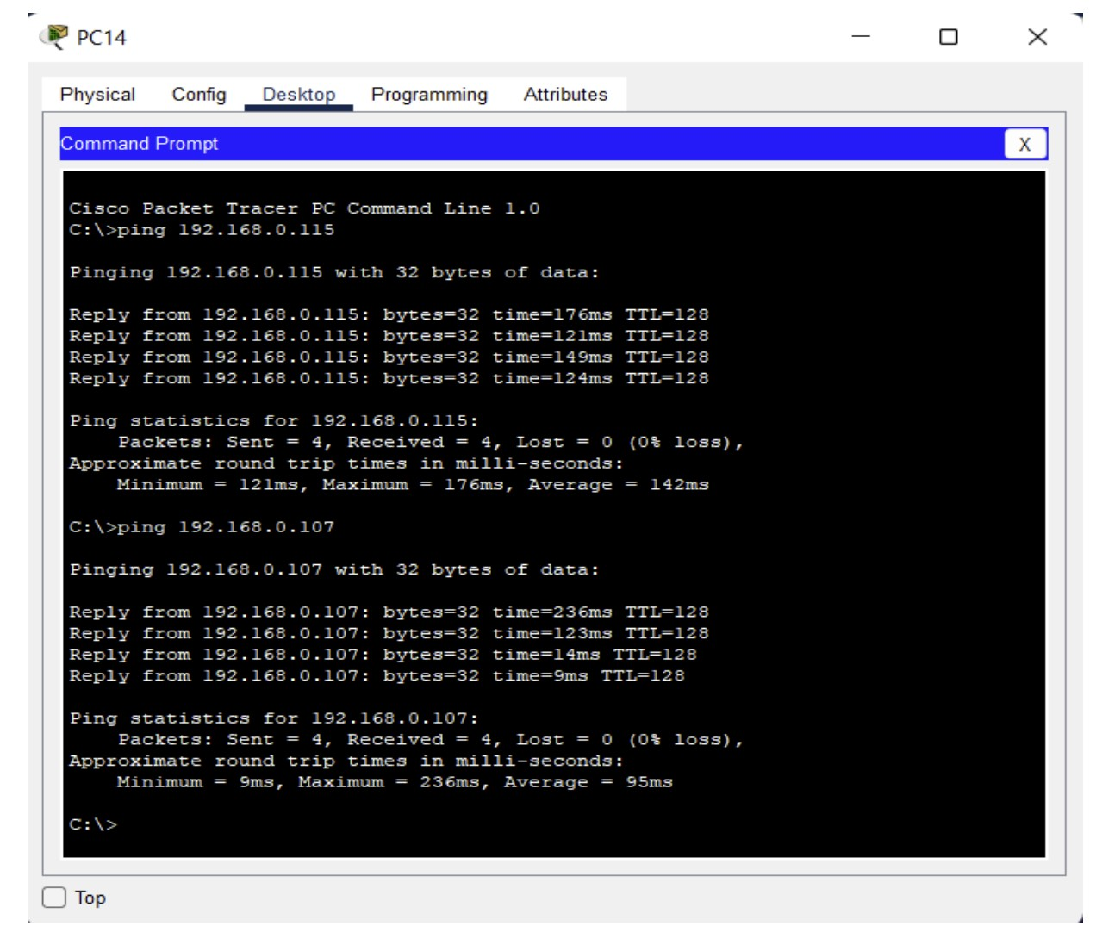
RESULTS:-
1. Main Building:

Slide 14

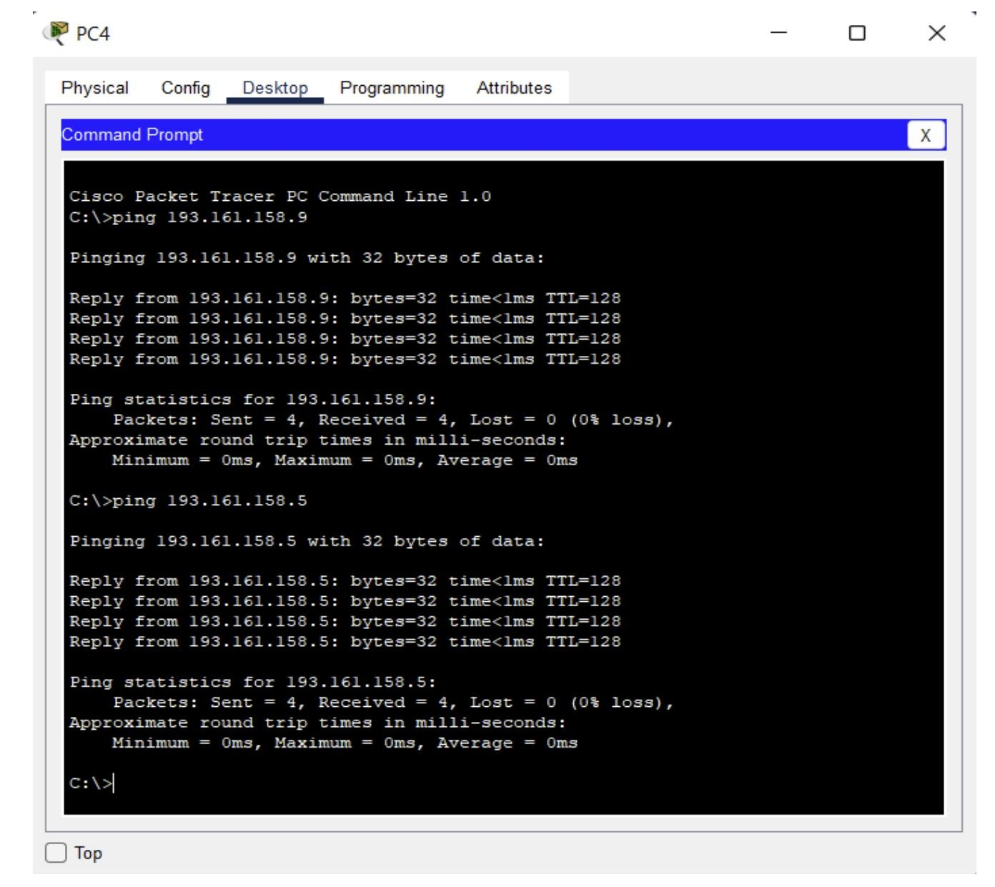
2. IT Park:

Slide 15

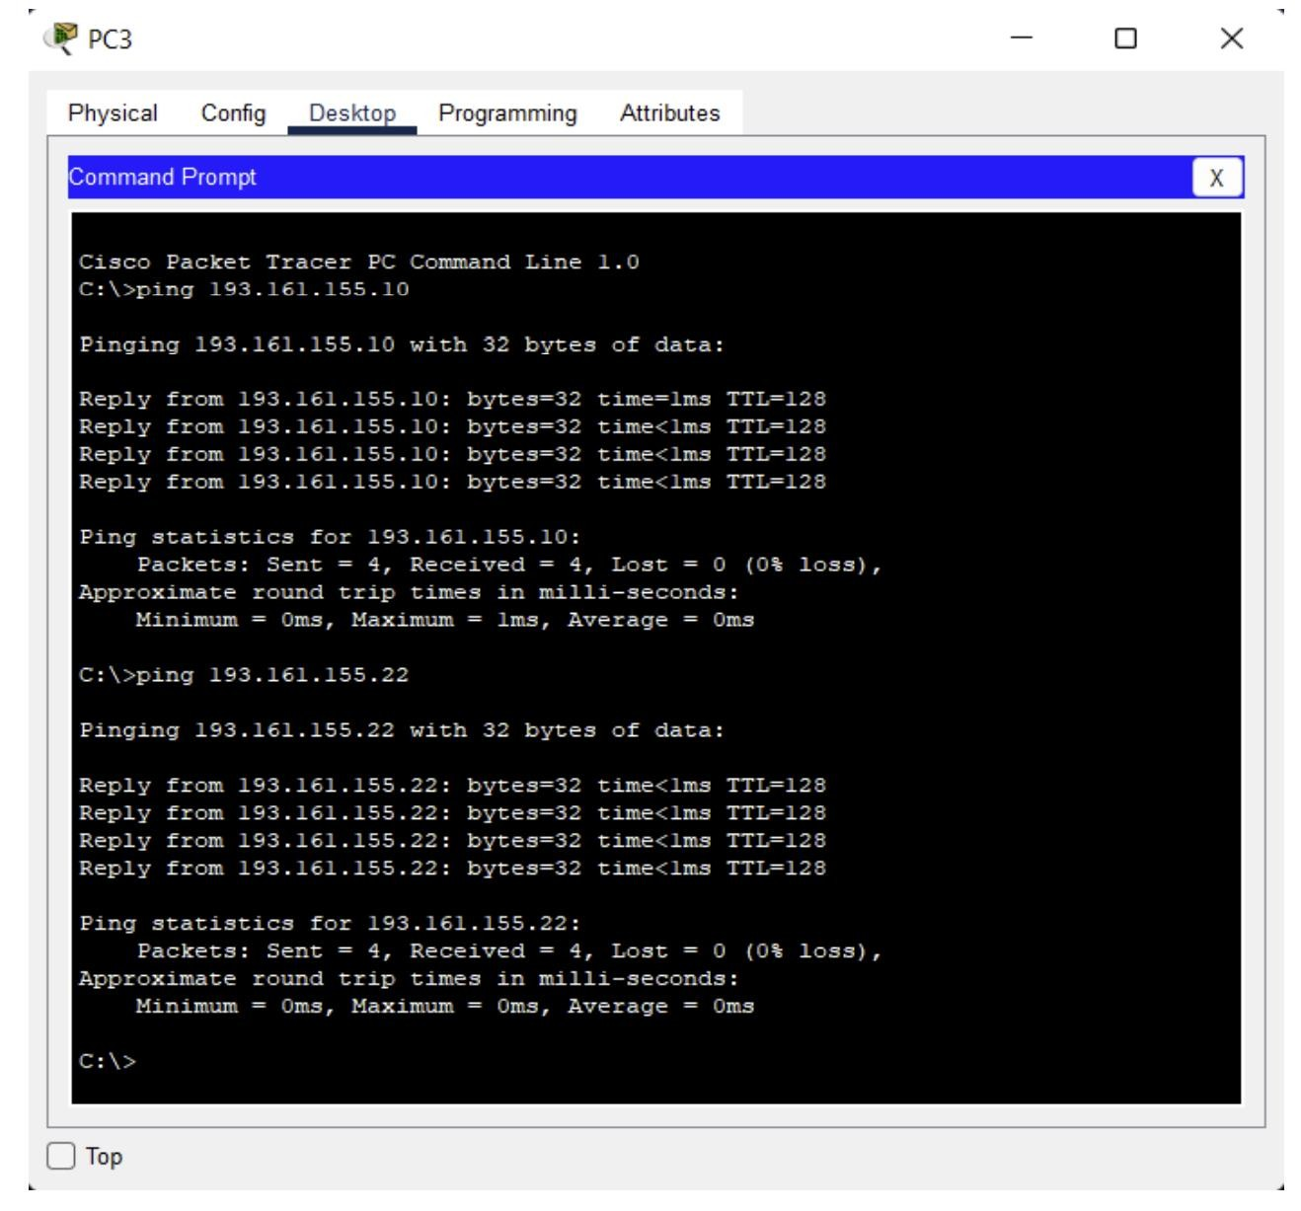
3. Business Park:

Slide 16
CONCLUSION: -
This project has proven that a standard network system can be designed with less cost. Although we used cheaper devices, in designing the network, security was considered paramount, and hence, the security of the network has turned out to be very strong. The utilization of DHCP helps the networks smoothly perform their functions. The advantage of networking can be seen clearly in terms of efficiency, manageability & cost-effectiveness as it allows collaboration between the users in a wide range. We utilized switches and routers for ease of transfer of data.

Slide 17
REFERENCES: -
https://www.networkcomputing.com/data-centers/campus-network-design-models
https://www.researchgate.net/publication/347998252_NETWORK_DESIGN_FOR_COLLE GE_CAMPUS
https://www.ciscopress.com/articles/article.asp?p=25259

